Slide 1

Soft-GRAF
Create a colorful HMI in the ISaGRAF PAC
ICP DAS CO., LTD.

Slide 2

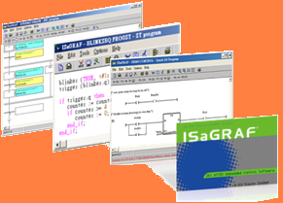

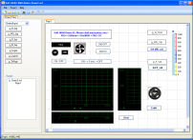
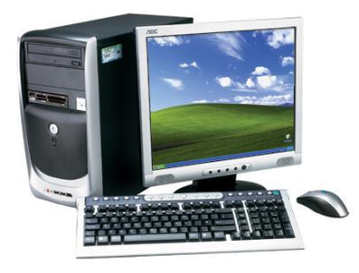







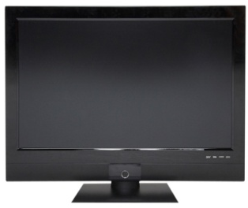

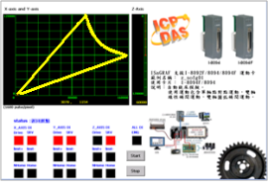
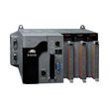
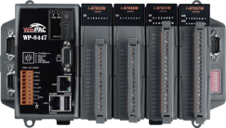
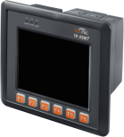
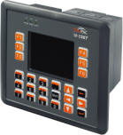


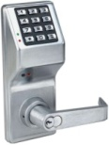



ISaGRAF + Soft-GRAF Studio
General Application
ISaGRAF
Soft-GRAF Studio
SoftLogic
HMI
All-in-one
XP-8xx7-CE6
WP-8xx7
VP-2xW7
I/O Control
FAQ-146 : www.icpdas.com > FAQ > Software > ISaGRAF

Slide 3
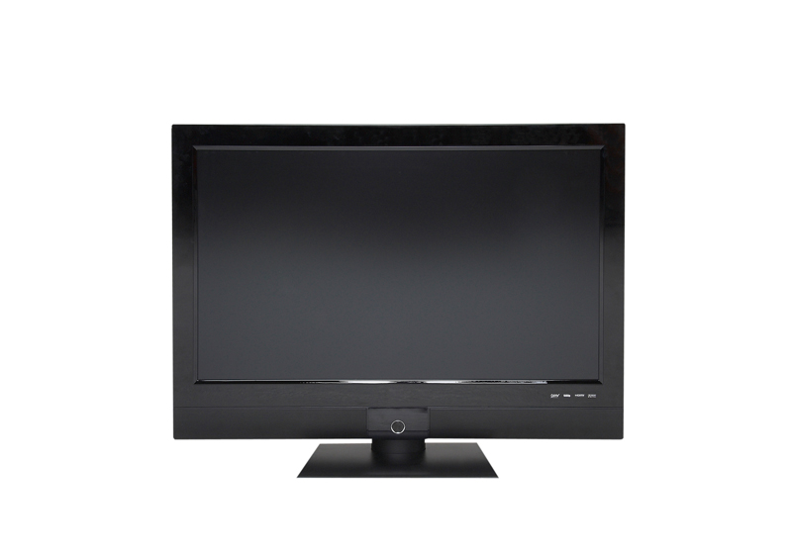
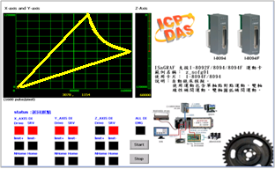
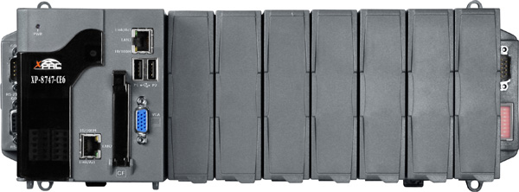
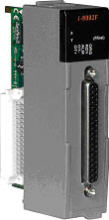
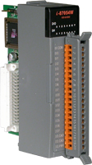
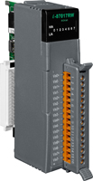



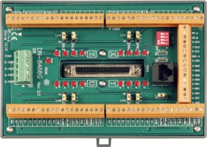
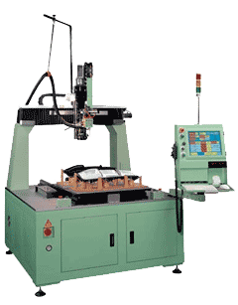
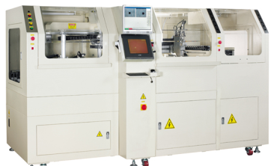
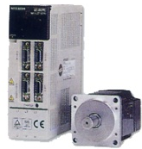
Motion Control Application
For ISaGRAF PACs: XP-8xx7-CE6
XP-8xx7-CE6
I/O Devices
I-8K, I-87K
Soft-GRAF HMI
Motion Card
I-8092F
I-8094F
I-8094
Daughter
Board
Motion Control
Servo Motors
Motion Devices

Slide 4

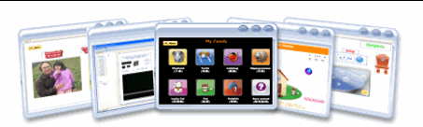
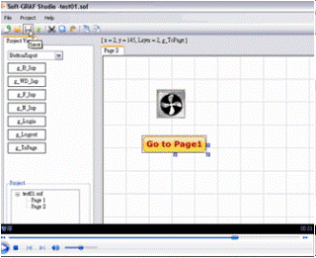
Get the Soft-GRAF Studio Software/Documents
Download All : FAQ-146
http://www.icpdas.com/faq/isagraf.htm > 146
My Sweet Home Video
http://www.icpdas.com/products/ Software/Soft-GRAF/soft-graf.htm
Soft-GRAF Studio Tutorial
http://www.icpdas.com/products/ Software/Soft-GRAF/soft-graf.htm

Slide 5
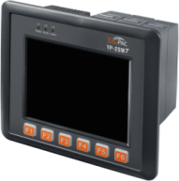
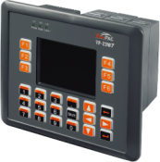
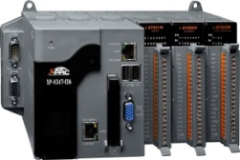
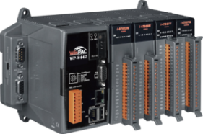
Ordering Information
Products | Model | Model
ISaGRAF Develop Software Workbench Ver.3 | ISaGRAF-256-E ISaGRAF-256-C | ISaGRAF-32-E ISaGRAF-32-C
ISaGRAF ViewPAC | VP-25W7 CR Ethernet WinCE 5.0 3 slots 5.7” LCD (Touch) | VP-23W7 CR Ethernet WinCE 5.0 3 slots 3.5” LCD (Without Touch)
ISaGRAF XPAC | XP-8047-CE6 CR XP-8347-CE6 CR XP-8747-CE6 CR Ethernet WinCE 6.0 0/3/7 slots VGA: 1024 x 768
ISaGRAF WinPAC | WP-8137/8437/8837 CR Ethernet WinCE 5.0 1/4/8 slots VGA: 1024 x 768 | WP-8147/8447/8847 CR Ethernet WinCE 5.0 1/4/8 slots VGA: 800 x 600

Slide 6
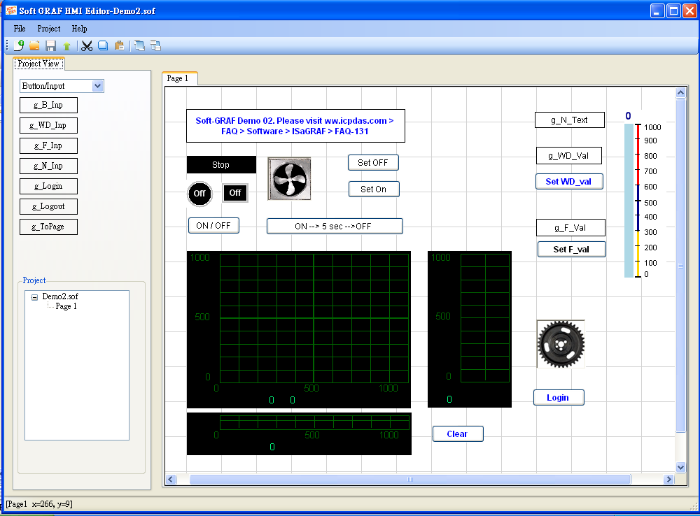
Soft-GRAF Studio HMI Design1
Graphical
drag and drop
Simple HMI editing
No programming writing

Slide 7
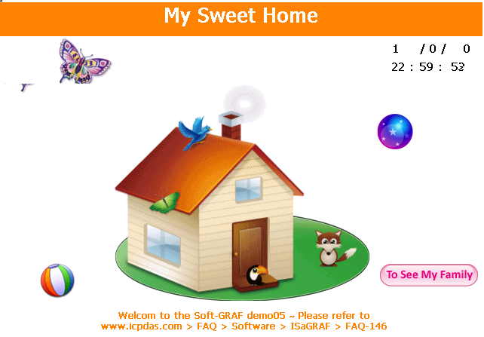
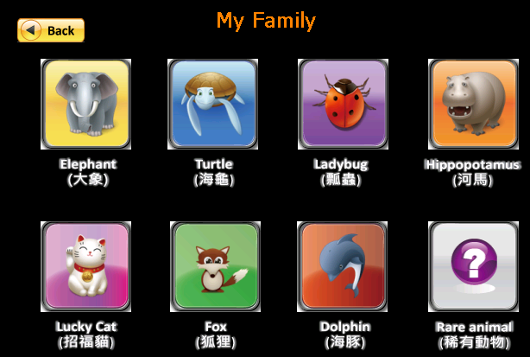
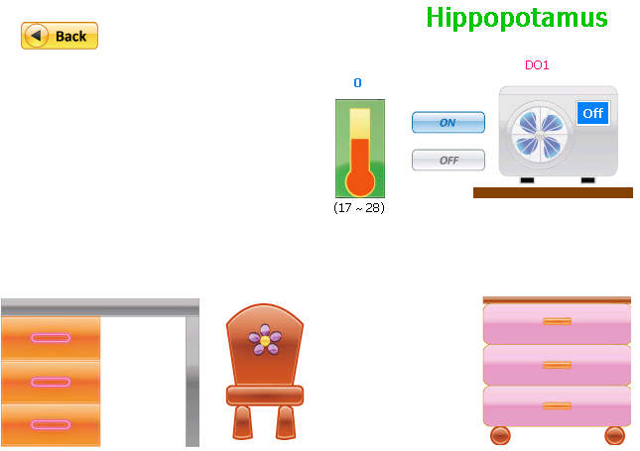
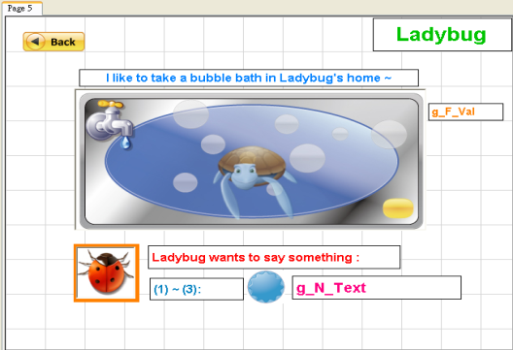
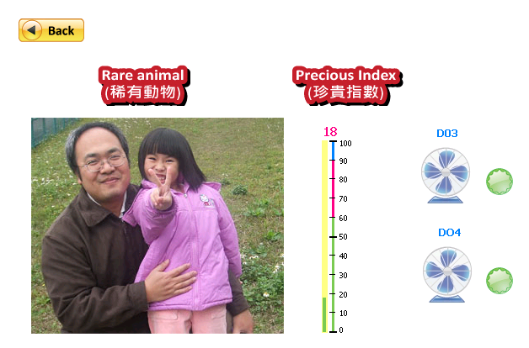
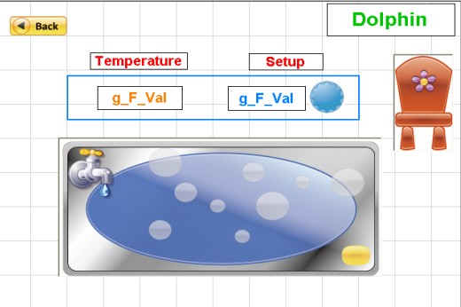
Soft-GRAF Studio HMI Design2

Slide 8
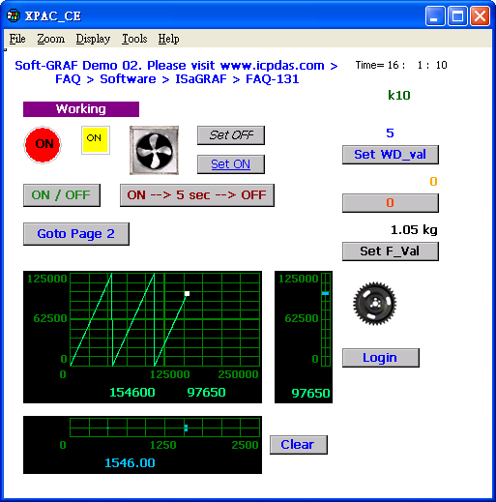
Objects Overview
Page
Text
Picture
Dynamic
Static
Numeric
Display
Input
Moving Trace
Bar-Meter

Slide 9
Object Type: Page
Create a HMI Page : g_Page
Max. 200 Pages
Page Title: Setup & Modify
Fore/Back Color: Setup & Modify
Multi-language Encoding:
bigb5 (Traditional Chinese)
gb2312 (Simplified Chinese)
UTF-8 (English)
Login Page: g_Login Logout Page: g_Logout Switch-Page: g_ToPage
Login Password Control
Login/Switch Level: 01~10
Switch page by Password
Setup confirmation dialog
Switch-Page button
Auto-logout function : 10 sec ~ 1 hr

Slide 10
Object Type: Text
Display a Label : g_Label
Display a Text with Label
Setup Position, Align
Setup Height, Width
Fore/Back Color
Text Content, Style
Text Size, Color
Display a Variable Text: g_N_Text
Display a Text by Integer variable
Setup Position, Align
Setup Height, Width
Fore/Back Color
Text Content, Style
Text Size, Color
Max. 50 different Texts by variable value 0~49
Max. 10 special settings:
Fore/Back Color
Blinking

Slide 11












Object Type: Picture
LED - Boolean Value : g_B_Led
Display different LED depending on Boolean value. (Ture/False)
Setup position, Height, Width, Color
Text Content, Style, Color
Soft-GRAF built-in various LED pictures
Picture- Boolean Value : g_B_Pic
Picture- Integer Value : g_N_Pic
Display Picture depending on Boolean or Integer value. (Two or Multi Status )
Setup position, Height, Width
Animated/Static Picture: Max. 50
Format: Support jpg, png, gif, bmp
Soft-GRAF built-in various animated and static pictures.

Slide 12
Object Type: Numeric
Numeric Display :
g_B_Val , g_WD_Val g_N_Val , g_F_Val
Display:
Boolean, 16-bit Integer value
32-bit Integer, 32-bit Float value
Setup position, Height, Width, Fore/Back Color
Size, Style, Color, Align
Digits, Decimal Digits
Blinking, High/Low Limit
Title/Unit Text: Part No., Unit, etc.
Numeric – Input button:
g_B_inp , g_WD_inp g_N_inp , g_F_inp
Display button: Picture, Text, Integer
Input: Boolean, 16-bit Integer value
32-bit Integer, 32-bit Float value
Setup position, Height, Width, Fore/Back Color
Size, Style, Color, Align
Digits, Decimal Digits
Blinking, High/Low Limit or no limitation
Title/Unit Text: Part No., Unit, etc.
Authority Control: Level 0 ~ 9
Confirmation dialog, Password Check

Slide 13
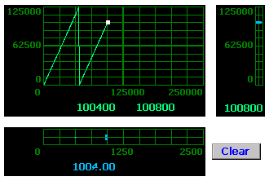
Object Type: Moving Trace
g_Trace2
Display a 1-axis or 2-axis Moving Trace
2-axis (X-Y)
1-axis (X: Horizontal)
1-axis (Y: Vertical)
Color:
Background, Trace Curve, Border, Current Point
Display Type of the Trace:
Stop, no drawing
Trace Curve & Current Point
Current Point
Clear old Trace & Redraw
Display the coordinates
High/Low/Left/Right Limit Value

Slide 14


Object Type: Bar-Meter
Vertical / Horizontal
Dynamic Display

Slide 15
Thank you!
Service : service@icpdas.com
Data Sheet : www.icpdas.com > ISaGRAF SoftLogic PAC > Data Sheet
FAQ : www.icpdas.com > FAQ > Software > ISaGRAF

